Slide 1






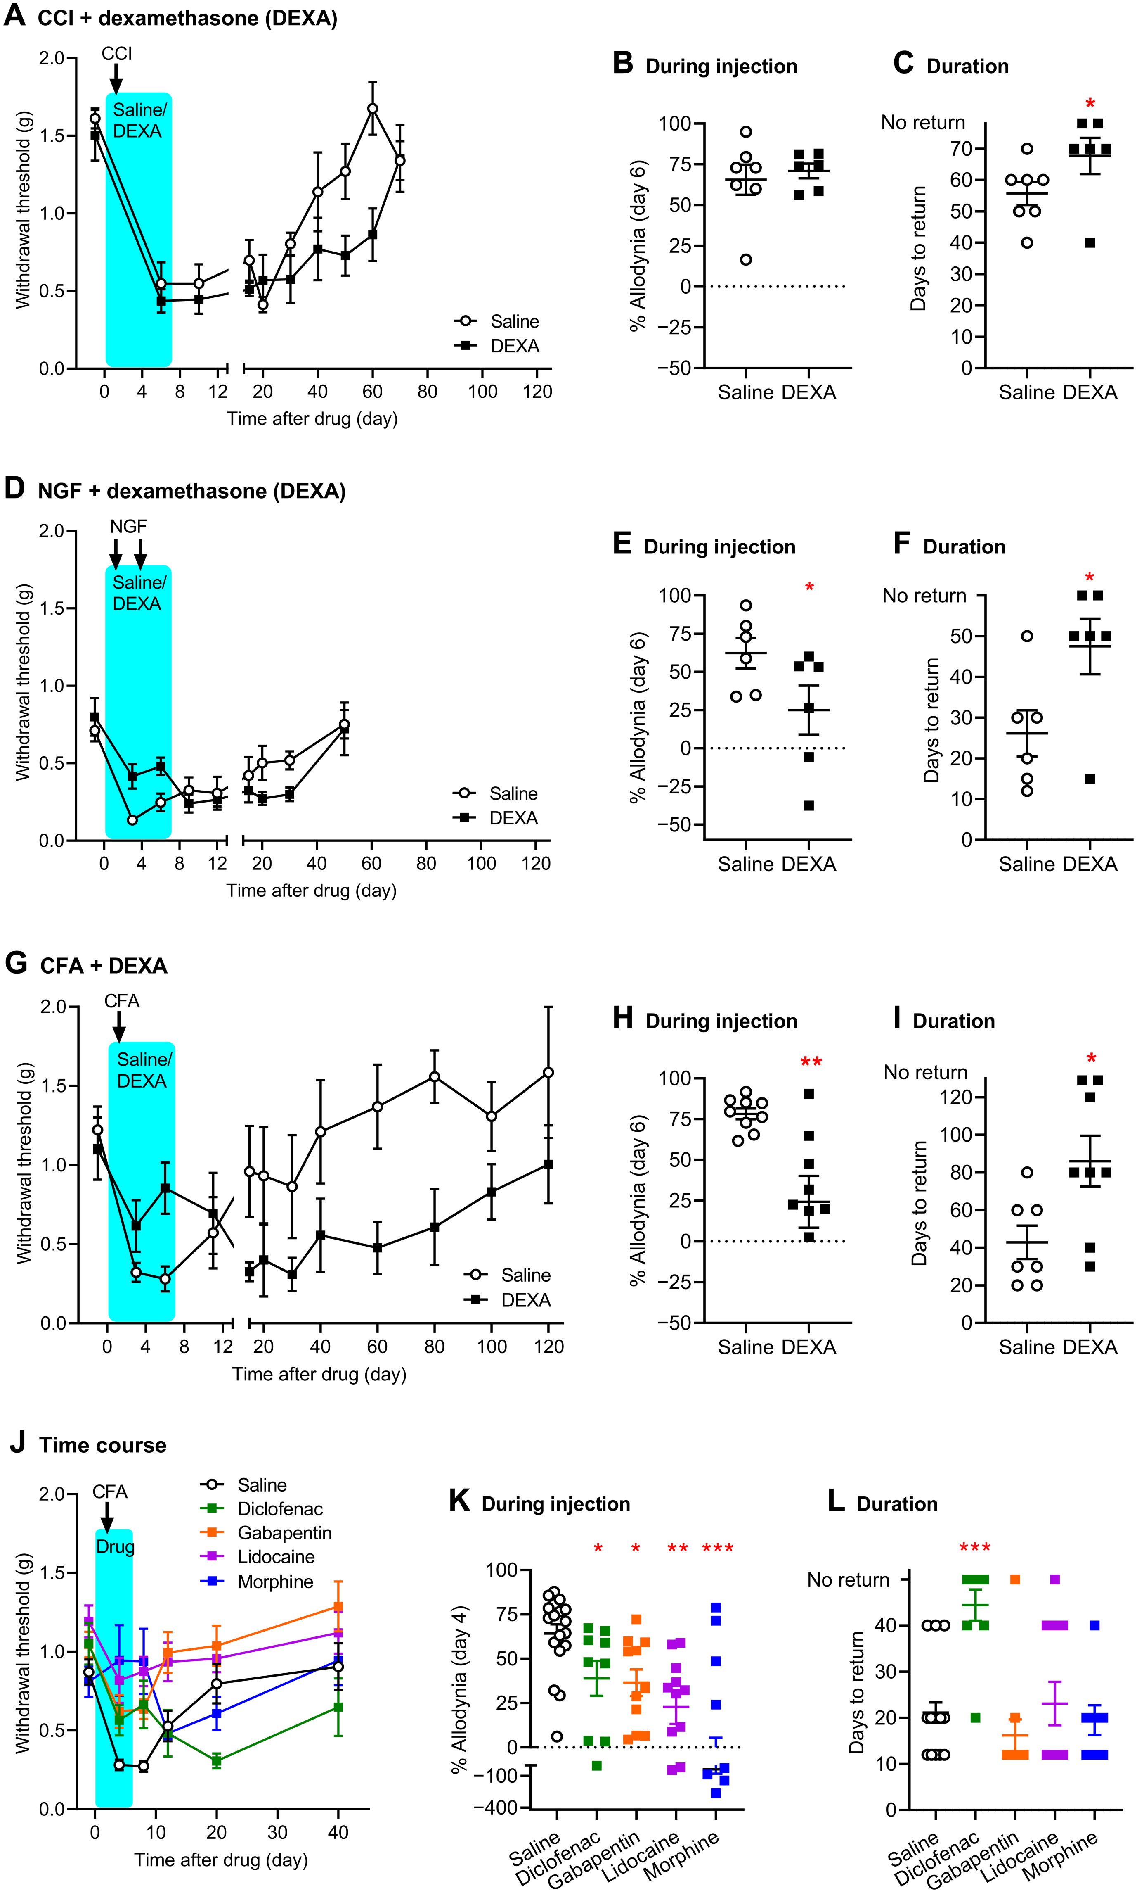
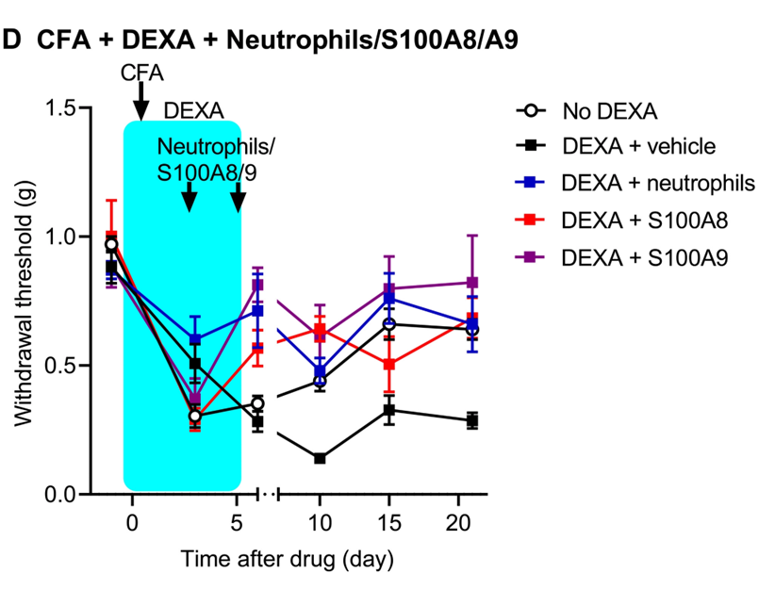
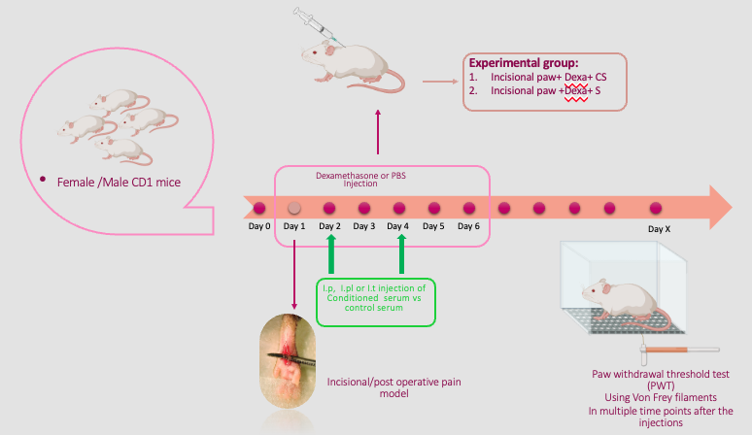





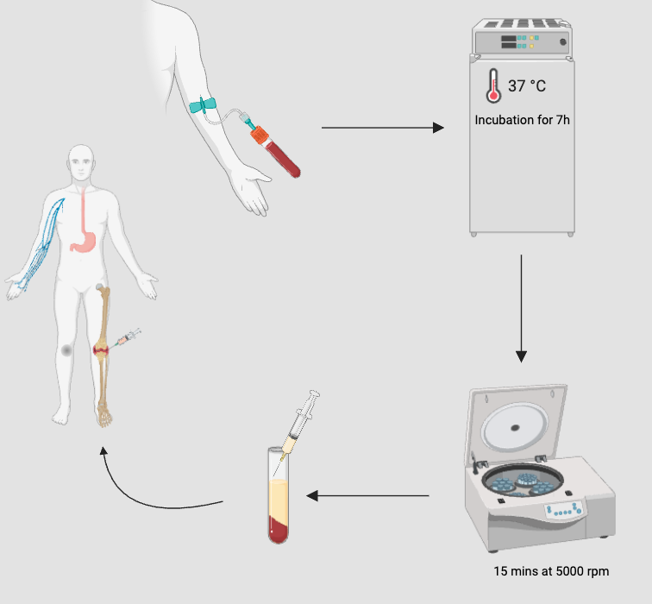
Abstract
The Role of Conditioned Serum in Preventing Long-Lasting Pain in a Chronic Post-Surgical Pain Model in Mice
A. Oveisi¹, L.V. Lima², M. Karaky³,J. Reinecke⁴, P. Wehling ⁴, J.S. Mogil², L. Diatchenko³
¹Department of Neuroscience, Faculty of Science, Alan Edwards Centre for Research on Pain, McGill University, Montreal, Quebec H3A 1G1, Canada.²Departments of Psychology and Anesthesia, Alan Edwards Centre for Research on Pain, McGill University, Montreal, Quebec, Canada. ³Faculty of Dental Medicine and Oral Health Sciences and Department of Anesthesia, Faculty of Medicine and Health Sciences, Alan Edwards Centre for Research on Pain, McGill University, Montreal, QC, Canada. ⁴ORTHOGEN AG, Dusseldorf, Germany.
.
Poster Number: WE391
Introduction
Results: Dexamethasone injections prolong the pain resolution following incisional paw surgery
Results: CS injections prevented Dexamethasone-induced chronic pain following incisional paw surgery
Results: CS injection at later time points prevent Dexamethasone-induced chronic pain following incisional paw surgery.
Post-operative pain is a primary concern of patients undergoing surgical procedures and presents major challenges for patients and clinicians. Over-the-counter analgesics like non-steroidal anti-inflammatory drugs (NSAIDs) are widely used for acute pain management. However, recent findings suggest that the inhibition of the inflammatory response in an acute pain state increases the odds of developing chronic pain¹.
A.
B.
E.
F.
K.
Conditioned Serum (CS) has been shown to be effective in treating different pain disorders such as osteoarthritis (OA)², trigeminal neuralgia³, and neuropathic spine disease⁴. The analgesic effect and the acceleration of tissue regeneration via CS have been attributed to the enriched concentration of anti-inflammatory components such as IL-1Ra, IL-4 and IL-10 and growth factors such as TGF-beta⁵. However, an administration of an anti-inflammatory molecule (IL-1Ra) fails to provide significant analgesia in treating OA⁶, suggesting that the actions of these mediators alone are insufficient to explain the long-lasting benefits of CS.
G.
H.
Figure 2: Paw withdrawal threshold was measured using Von Frey testing in mice after incisional paw + Dexamethasone and CS injection on days 2&4 or 28&30 (K). Green and Blue arrows represent the time of CS/S injections .
Neutrophils and neutrophil-released proteins S100A8 and S100A9 prevent the development of pain caused by Dexamethasone in the mouse.
C.
D.
Conclusion
Our results validated the previously reported observation that inhibiting active biological processes at the acute state of injury greatly prolongs pain resolution in a new and commonly used clinically relevant mouse model of postoperative pain.
CS intraplantar and intraperitoneal injections prevent long-lasting pain induced by dexamethasone in post-surgical models.
CS intrathecal injections did not prevent long-lasting pain induced by dexamethasone in post-surgical models.
CS intraplanar injections resolve long-lasting pain induced by dexamethasone in post-surgical models.
Pain behaviour in our model resolves spontaneously unless the immune/inflammatory response is inhibited by DEXA. CS restores this immune response and protects from transitioning to chronic pain.
I.
J.
Figure 1: Paw withdrawal threshold was measured using Von Frey testing in mice after incisional paw and Dexamethasone/PBS treatments in male (A) and female mice (C). Days until recovery is plotted for male (B) and female (C) mice. Paw withdrawal threshold was measured using Von Frey testing in mice after incisional paw, Dexamethasone/PBS treatments and injection of CS intraplantar (E), intraperitoneal (G) and intrathecally (I). Days until recovery are plotted in (F), (H) and (J) respectively. Symbols represent mean ± SEM 50% withdrawal thresholds (g). Green arrows represent the time of CS/S injections.
Methodology & Method
Results: CS injections did not produce analgesia in the SNI model of neuropathy
Acknowledgement
Subject: 6–8-week-old CD-1 mice of both sexes were used. All mice were housed under standard laboratory conditions, having 12h of light/dark cycle and had access to water and food ad libitum.
Post-Operative Pain Model and Pain Assessment: Post operative incision model is performed based on Cowie et al. protocol⁷. Tactile allodynia was measured using Von Frey filaments. 50% paw withdrawal threshold was then calculated using the up-and-down method.
Conditioned Serum Preparation: 50 mL of whole blood was taken from each patient using a special syringe (Orthogen, Dusseldorf, Germany). After incubation for 7 hours at 37 °C, the blood-filled syringes were centrifuged for 15 mins at 5000 rpm, the serum supernatant was then removed and aliquoted into 6 mL portions. The aliquots were stored at -20°C until use.
Pharmacological Treatments: Mice received 0.5 mg/kg/day of the corticosteroid dexamethasone (DEXA), or 1% DMSO subcutaneously for six consecutive days. On days 2 and 4 post-surgery, 10 microliters of conditioned Serum (CS) or Control Serum (S) were injected intraplantar (i.pl.) or intrathecally (i.t.).
Statistical Analysis: Data collected individually from each subject has been calculated into group means and analyzed using Student’s t-test or analysis variance (ANOVA) followed by Tukey’s or Dunnett’s post hoc testing as appropriate.
.
L.
This work was funded by Canadian Institute of Health Research (CIHR-CERC) as well as a fellowship by ORTHOGEN AG. We thank the Quebec Pain Research Network (QPRN) for their travel award.
Dr. Luda Diatchenko Luda.diatchenko@mcgill.ca
Anahita Oveisi anahita.Oveisi@mail.mcgill.ca
M.
References
Parisien, M., Lima, L. V., Dagostino, C., El-Hachem, N., Drury, G. L., Grant, A. V., Huising, J., Verma, V., Meloto, C. B., Silva, J. R., Dutra, G. G., Markova, T., Dang, H., Tessier, P. A., Slade, G. D., Nackley, A. G., Ghasemlou, N., Mogil, J. S., Allegri, M., & Diatchenko, L. (2022). Acute inflammatory response via neutrophil activation protects against the development of chronic pain. Science Translational Medicine, 14(644). https://doi.org/10.1126/scitranslmed.abj9954
. Motaal, F. K. A.-E., Elganzoury, A. M., Fathalla, M. M. & Abdulkareem, O. Low-dose intra-articular autologous conditioned serum in treatment of primary knee osteoarthritis. Egypt Rheumatol Rehabil 41, 98–102 (2014).
3. Aghamohammadi, D., Saharifi, S., Shakouri, S. K., Eslampour, Y. & Dolatkhah, N. Autologous conditioned serum (Orthokine) injection for treatment of classical trigeminal neuralgia: results of a single-center case series. J Med Case Reports 16, 183 (2022).
4. H. S., R. K., Goni, V. G. & Y. K., B. Autologous Conditioned Serum as a Novel Alternative Option in the Treatment of Unilateral Lumbar Radiculopathy: A Prospective Study. Asian Spine J 9, 916 (2015).
5. Kerscher, M., Hertz-Kleptow, D., Drabik, A., Kaptan, T. & Reinecke, J. Cell-Free Blood Cell Secretome (BCS) Counteracts Skin Aging and Restores Firmness and Elasticity. 20, (2021)..
6. Chevalier, X. et al. Intraarticular injection of anakinra in osteoarthritis of the knee: a multicenter, randomized, double-blind, placebo-controlled study. Arthritis Rheum 61, 344–352 (2009)
7. Cowie AM, Stucky CL. A Mouse Model of Postoperative Pain. Bio Protoc. 2019 Jan 20;9(2):e3140. doi: 10.21769/BioProtoc.3140. PMID: 30820443; PMCID: PMC6390978.
Figure 3:. Paw withdrawal threshold was measured using Von-Frey testing after SNI/Sham surgery (a pink arrow represents the timing of surgery) and after CS/S injections (represented by green arrows) intraplantar (L), intramuscular (M). Symbols represent mean ± SEM 50% withdrawal thresholds (g) of SNI and sham mice.

